Slide 1
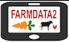
13 –FarmData2 Developer Installation
COMP 190 – Dickinson College
Fall 2021
Notes:
Thus far you have worked with the FarmData2 repo
- well a fork of it just for this class
You made updates to some of the documentation
- while learning about version control and git/GitHub
That did not require actually running the application
If you want to make code changes that
- fix bugs
- add features
Then you will need to do a “Developer Installation”
A Developer Installation will give you the ability to
- run FarmData2 on your machine
- add, modify and test code
Today’s activities are about
- setting up that developer installation.
- beginning to become familiar with how FarmData2 works.

Slide 2
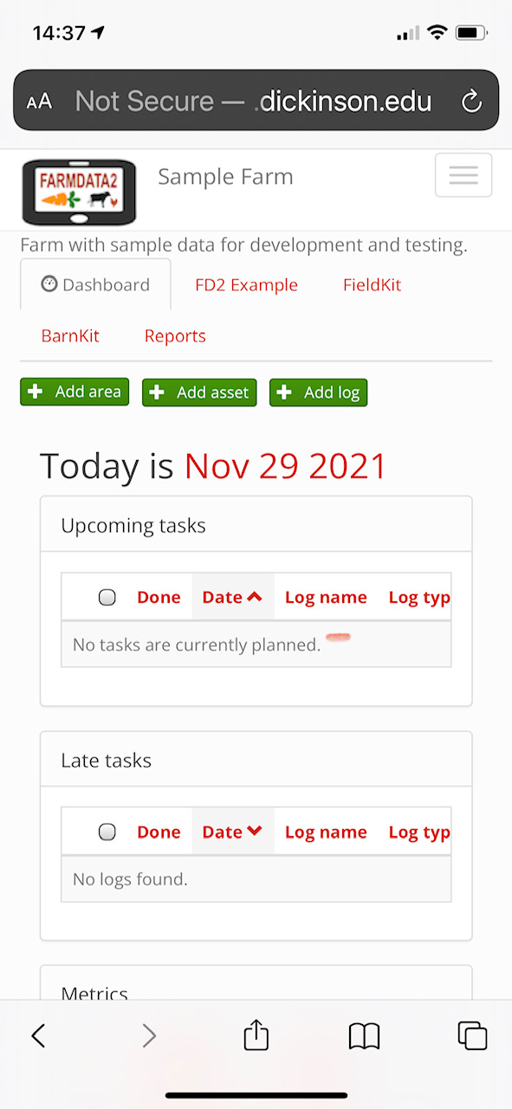
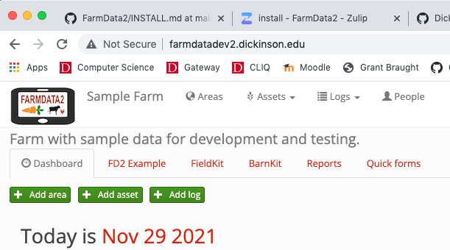
FarmData2
Notes:
FarmData2 is a web application.
It will run in a browser.
Or on a mobile device.

Slide 3
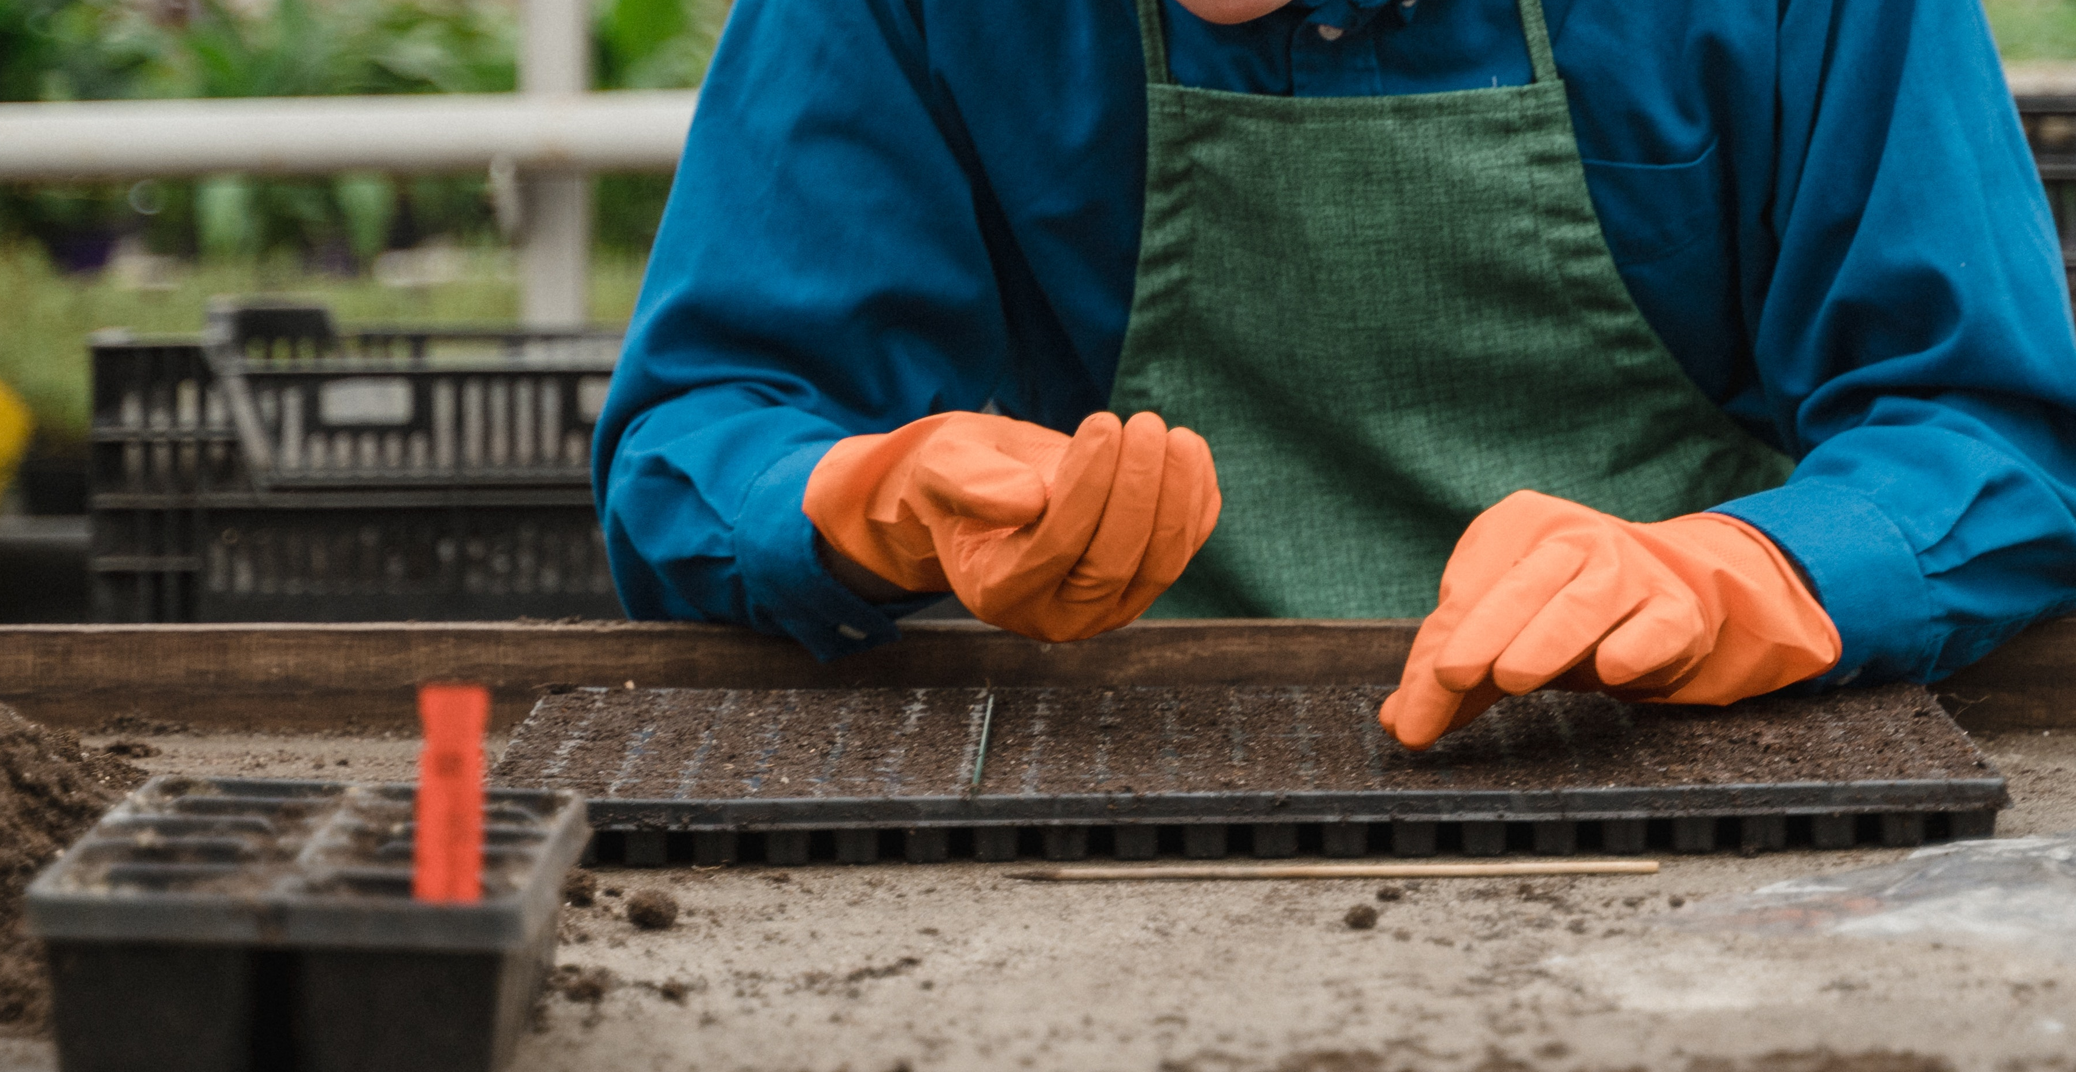
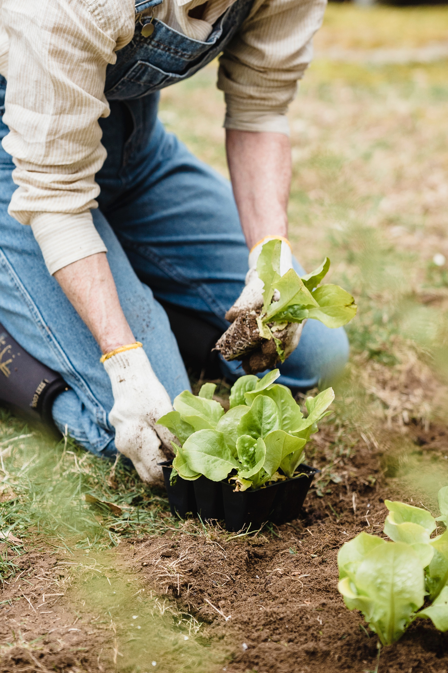
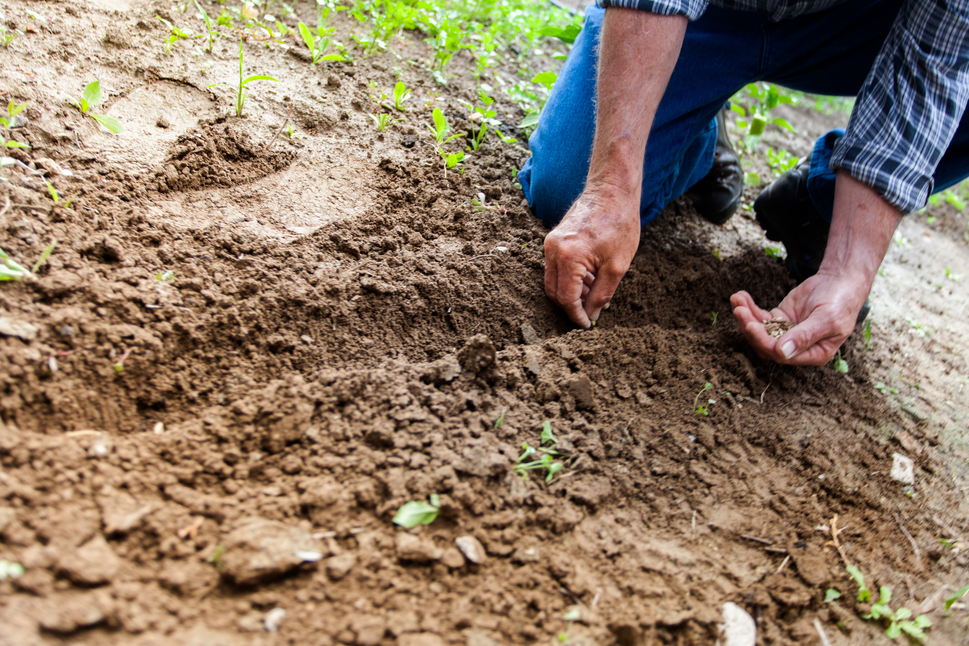
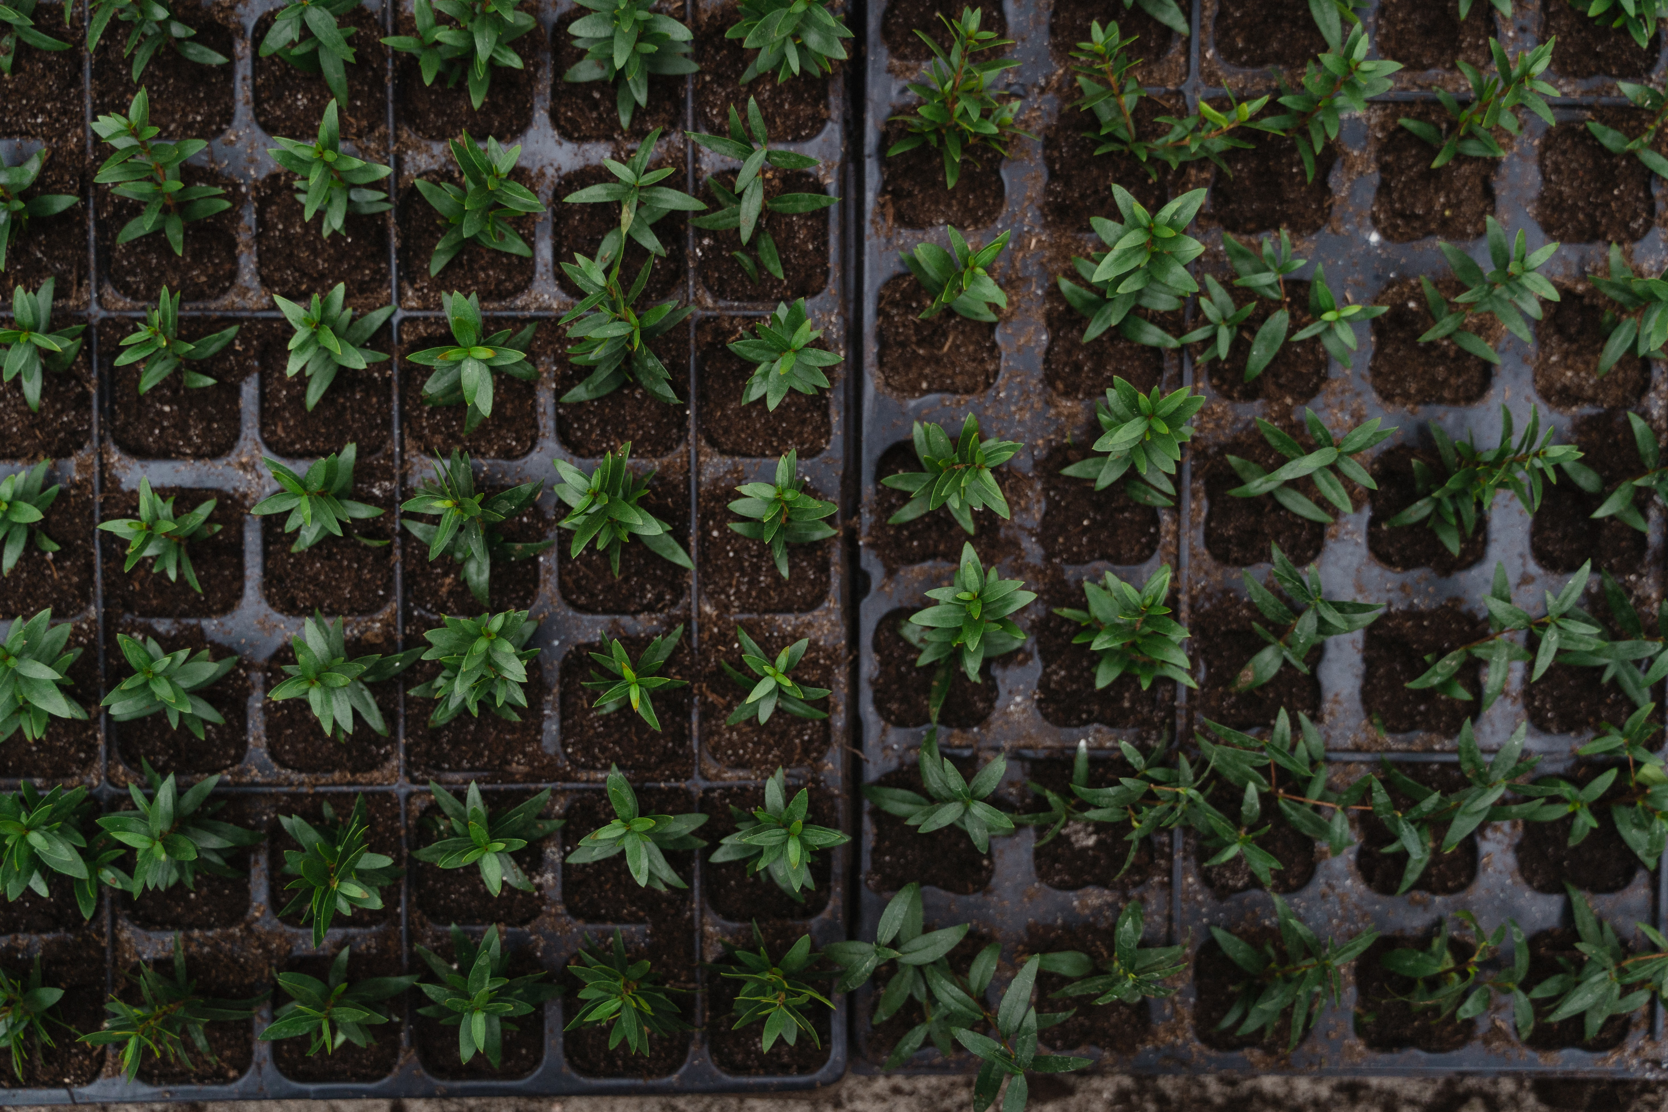
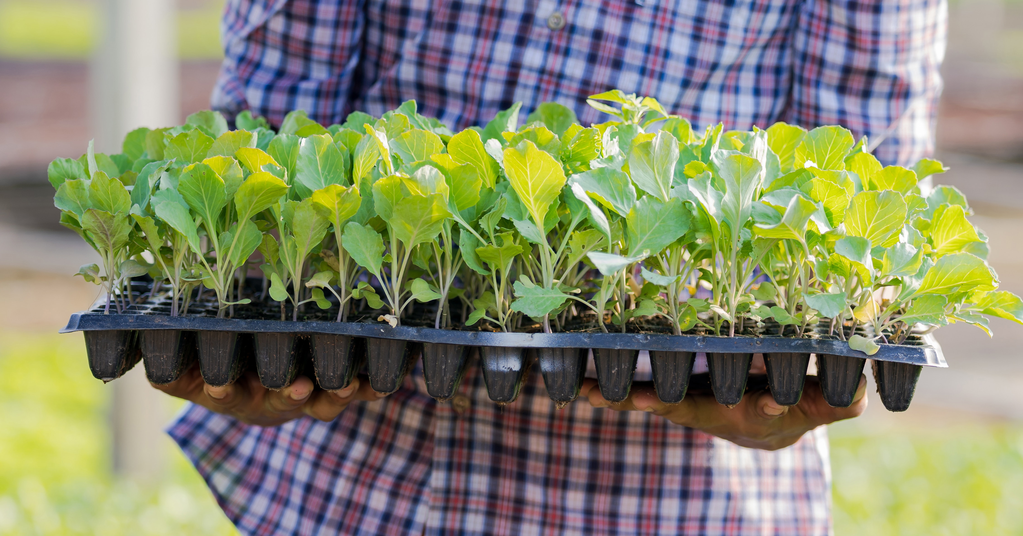
Terminology: Plantings
Tray Seeding
Transplanting
Direct Seeding
Photos by Tima Miroshnichenko from Pexels
Photo by Binyamin Mellish from Pexels
Photo by Greta Hoffman from Pexels
Photo by Sorapong Chaipanya from Pexels
Notes:
We’ll need some minimal farming terminology to work with FarmData2
Direct Seeding
- placing seeds directly in the ground to grow.
Tray Seeding
- planting seeds in cells in a tray to begin growing in a greenhouse.
Transplanting
- Moving plants that were tray seeded into the ground.

Slide 4
Terminology: Beds, Rows, Bed Feet, Row Feet
Notes:
Planting bed is the width of the tractor wheel tracks.
If length of the bed is 100 feet then
- we say we have 100 bed feet.
If we plant one row of crops in the bed then
- we say we have 100 row feet.
If we plant three rows of crops in the bed then
- we say we have 300 row feet.

Slide 5
FarmData2 Demo
Quick demo of FarmData2
http://farmdatadev2.dickinson.edu/
Login
BarnKit:
Seeding Report
FieldKit
Seeding Log
Notes:
Login: worker1, farmdata2
BarnKit:
- search for 05/01/2019 to 05/15/2019 works well.
- Filters
- tray seedings vs direct seedings
- Crop
- Area (i.e. field)
- Can edit and delete rows
- Summary Tables
- Useful for future planning
- e.g. how long does it take to plant
Field Kit:
- Make a new planting
Much more to be done…
- transplanting records
- harvest records
- 290!

Slide 6
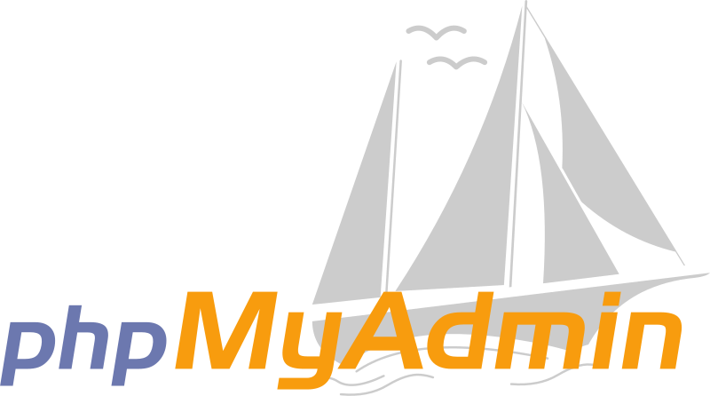

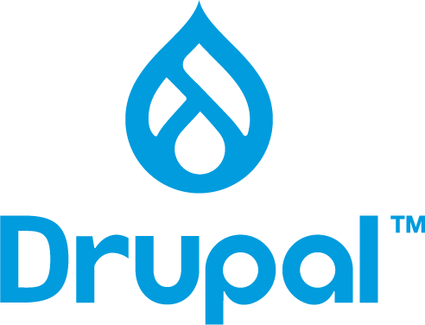


FarmData2 Technology
FarmData2 uses an Open Source technology stack including:
The FarmOS Project
The Drupal Project
Apache Web Server
Mariadb Database Server (a mySQL fork)
phpMyAdmin
Theia (IDE)
Notes:
farmOS
- general purpose farm management, planning, and record keeping application
- not specialized to small organic farms
- that’s our job.
Drupal
- Content managements system on which farmOS is built.
- handles the organization and display of data
Apache Web Server
- Serves the pages that makeup the application
MariaDB
- stores all of the data (e.g. direct and tray seedings)
phpMyAdmin
- Tool for working directly with the database
- we won’t be using this at all.
Theia
- An IDE that runs in your browser.
- Makes it easy to work on FarmData2 code.
All of this is open source!

Slide 7
docker / docker-compose
docker-compose is a tool that creates and starts multiple docker containers and connects them via a virtual network.
FarmData2 Containers:
Mariadb Apache/FarmOS/Drupal
phpMyAdmin Theia
Mariadb
Apache
Drupal
farmOS
phpMyAdmin
Apache
Theia
Apache
App
App
Libs/Bins
Libs/Bins
Libs/Bins
Libs/Bins
Libs/Bins
OS Kernel Virtualization
Container Daemon (containerd)
Host Operating System
Hardware
Notes:
Seem like all of that might be a lot to setup.
- lots of prerequisites and dependencies
- docker is part of the solution
- docker-compose is the rest
Containers for:
- The database – mariadb
- The farmOS system including
- drupal and a web server
- the phpMyAdmin application
- Including a web server for it
- The Theia IDE
- Including a web server to serve it.
docker-compose
- provides a relatively easy way to start all of those containers
- and ensure that they can talk to each other
- e.g. farmOS can communicate with the database.
- e.g. Theia can see the code and changes are seen by drupal and farmOS.

Slide 8
What’s Next?
A13 – 1 week
No Quiz
Revise and resubmits
Readings for discussion
Notes:
In A13 you will:
- check your VM to be sure it is suitable for FD2 development
- if not you may need to create a new one.
- Install the prerequisite dependencies
- Install FarmData2
- Do some exercises using FarmData2
- Will help you get familiar with it.

Slide 9

Acknowledgments:
Slide Template From:
https://creativecommons.org/licenses/by/4.0/
Slide Content Licensed as:
https://creativecommons.org/licenses/by-nc/4.0/

